Slide 1
Chapter 17
Households

Slide 2

Spending to fulfil everyday needs. This private consumption includes both goods and services. Such has food, clothing leisure & entertainment
Influence on spending
Disposable Income
is the amount of money an individual has to spend on goods and services.
There is a positive relationship between the level of spending and the amount of income earned; higher levels of disposable income usually lead to higher levels of spending.
The Wealth Effect
Wealth represents the value of a stock of assets
For most people the majority of their wealth is held in property, shares in quoted companies on the stock market, savings in banks.
for example a sustained fall in house prices might cause a decline in personal wealth and spending as homeowners have less housing equity available to borrow.
This is sometimes referred to as the negative wealth effect.
Housing equity is the difference between the market value of property and the outstanding mortgage loan.
Effects Confidence
A House value of $500,000
Loan of $250,000
Equity (wealthy) $250,000
B Market value. $300,000
Loan still same $250,000
Equity (wealth). $50,000
Notes:
Disposable income is the amount of money an individual has to spend on goods and services. There is a positive relationship between the level of spending and the amount of income earned; higher levels of disposable income usually lead to higher levels of spending.

Slide 3
Consumer Confidence
for example, fears of rising unemployment and expectations of higher taxes will hit consumer sentiment and spending.
If you don’t have enough confidence, you are unlikely to go ahead with major purchases such as a new car or kitchen.
Interest Rates
lower interest rates cuts the cost of paying the debt on a mortgage and increases the effective disposable income of homeowners.
The Distribution of Income
Lower income families tend to have a higher propensity to consume than better-off households (who tend to have a higher savings ratio).
Thus a redistribution of income towards poorer families may have the effect of boosting total consumer demand.
Lower income earners spend a greater proportion of their income on food and necessities.
High income earners spend a lower proportion of their income on food and necessities as they can afford to also buy luxury items.
Advances in new technology such smart phones, TV’s will encourage to spend

Slide 4
Consumption
People will divide their disposable income between spending and saving
The more disposable income people have the greater their potential consumer expenditure
People will consume those goods and services that provide them with the most satisfaction or utility

Slide 5
The Propensity to Consume
What matters is the rate at which consumers increase their spending as income rises.
This is called the marginal propensity to consume.
Say that someone receives extra pay of £2000 in a year and they spend £1500, thus the marginal propensity to consume is £1500 / £2000 = 0.75.
The remainder is saved so the marginal propensity to save is 0.25.
A simple rule to remember is that the marginal propensity to consumer added to the marginal propensity to save must always equal 1.
Generally, people on lower incomes tend to have a higher propensity to spend.
This matters when the government announces changes in taxation and the level of welfare benefits.
A fall in the marginal propensity to spend will cause a lower level of consumption for a given level of income.

Slide 6
Relationship between Disposable Income and Consumption
People can either spend or save their disposable income.
When people are very poor, they cannot afford to save. All of their disposable income will be spent on buying basic necessities to survive.
When people spend more than their income, they are said to be dissaving.
This is because they are either drawing on their past saving or more likely, borrowing other people’s savings.
As income rises people are able, to both spend and save more.
The proportion of income which people spend is sometimes referred to as the average propensity to consume (APC). It is calculated by dividing consumption by disposable income.
Disposable income ($) | Consumption ($) | APC
100 | 120 | 1.2
200 | 200 | 1.0
300 | 270 | 0.9
400 | 320 | 0.8
500 | 350 | 0.7

Slide 7
Income & Consumption
At high levels income at C
There is expenditure rises but at a lower rate
Consumption
Y
Consumption
At low levels income at A
There is dissaving
0
A B C
Disposable Income
At level B no saving all income is spent

Slide 8
Why do our spending patterns differ?
Our individual spending (and saving) patterns depend on our preferences, economic circumstances and characteristics
INCOME
TASTES
WEALTH
LIFESTYLE
AGE
FAMILY CIRCUMSTANCES
CULTURE

Slide 9
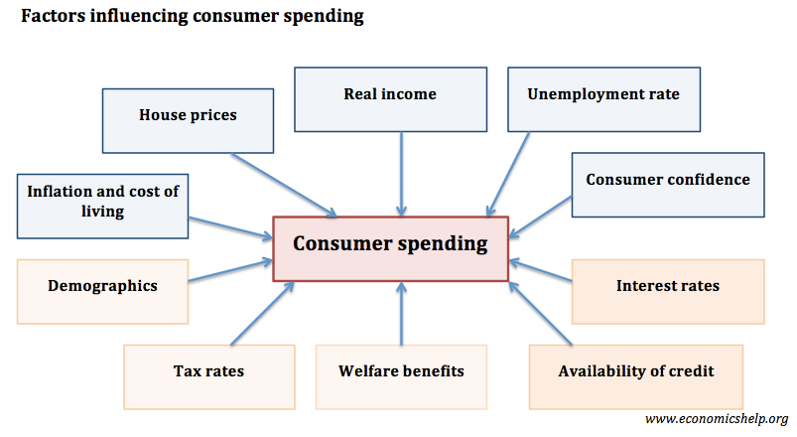

Slide 10

Saving is income not spent, or deferred consumption.
Saving is disposable income that is not spent
The savings ratio is the % of disposable income saved rather than spent e.g. if a person has an annual income of £25,000 and saves £2500 of this, then the savings ratio is 10%
A high savings ratio (other factors remaining equal) lowers consumption and aggregate demand

Slide 11
WHY DO PEOPLE SAVE?
People save money because:
For any particular objective eg car/holiday
For retirement , to supplement the pension
For emergencies Unexpected problems eg lose jobs
For Children's education or inheritance
Of increasing current income with high rate of interest attract to save more.
PENSION
SCHEME
For future spending

Slide 12
What factors affect how much of their income people save?
Real interest rate on savings deposits may increase saving
Income as incomes increase more proportion is saved (saving ratios)
Wealth (easier to save)
Expectations of future income and job security / all linked to consumer confidence
Availability of credit – borrowing to finance extra spending counts as dis-saving
The need to save to repay debt
The availability of savings institutions such as banks and our trust in those institutions.
Age structure – Old (use it to for living standards & Young tend not to save
Social attitudes- Some countries held in high esteem others spend most of the income.
Taxation of saving e.g. tax efficient savings schemes and tax relief on occupational pensions such may encourage people to put away more of their disposable income and no tax earned on interest
FOR WEDNESDAY CLASS
New tax-free savings account
Notes:
\

Slide 13
Age
25
influenced by government support in terms of old-age pensions and health care provision.
Attitude to saving
Every person is different
USA/UK borrow/Credit card to buy
Japan/Chinese Less borrowing more saving .
The level of savings is affected by the following factors
Interest rates
⬆interest rates need to pay more on loan thus less to save
⬆ interest rates people with spare cash will save.
⬇ interest rates more spending & low return on saving
Consumer and business confidence
Confidence in economy less savings people spend more
recessions when consumers are feeling less optimistic about the future will save more

Slide 14
Investigate the savings ratio of Indonesia and compare it with other countries, analysing why they are different and considering whether the savings ratios are likely to change in the future.
See data.oecd.org and data.worldbank.org: search for ‘savings rate’ or ‘gross domestic savings’.
Investigate the levels of borrowing and personal debt in the their own country and compare it with other countries, analysing why they are different and considering whether levels of borrowing and personal debt are likely to change in the future.
See data.oecd.org and search for ‘household debt’. See also www.cityam.com/1411501631/debt-map.

Slide 15
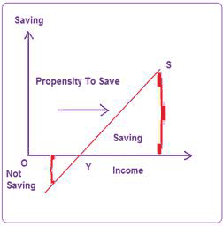
Average propensity to save (APS):
The ratio of total saving to total income is called APS. Alternatively, it is that part of total income which is saved.
By dividing total saving (S) with total income (Y), we get APS.
Thus at $500 we get 30% of saving
Disposable income | Consumption | Saving | APS
100 | 120 | -20 | -0.2
200 | 200 | 0 | 0
300 | 270 | 30 | 0.1
400 | 320 | 60 | 0.2
500 | 350 | 150 | 0.3

Slide 16
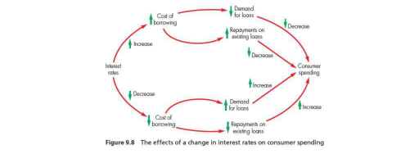

Slide 17



Borrowing
Personal bank loan
A consumer may borrow money to increase their expenditure on goods and services
They can then make repayments overtime from future earnings
The total stock of accumulated borrowing by a person is called their personal debt
Bank overdraft
Credit cards
Credit cards – (Ways of borrowing)
Credit allows people to purchase goods and services with deferred payment.
'buy now and pay later'. Nil interest or high
Can be very high 35.81%.
Mortgage
Hire purchase

Slide 18
Factors that affect the level of borrowing in an economy include the following:
Availability of funds (interest rates) –
Banks and other financial institutions lend money.
The central bank of a country controls the amount of founds in an economy
Central sets cash reserve ratio
A decrease or increase in the cash reserve rate ratio will effect funds are available for lending.
Consumer confidence:
How confident people feel about financial situation in the future may affect borrowing, too. For example, if they think that prices will rise (inflation) in the future, they might borrow now, so that they can make big purchases.
Wealth
Wealth of a person may affect their level of borrowing (less wealthy customers have a higher risk of defaulting on the loan (being unable to repay their borrowing).
To avoid bad debts (debts that cannot be repaid), banks often make sure that they have some guarantee of getting their money back.
Use of collateral (security)
Social attitudes
Countries have different attitude towards debt and some groups within countries may differ as well
http://www.theasianbanker.com/updates-and-articles/household-debt-highest-in-australia,-while-china-sees-fastest-growth
Notes:
,asabank will be more willing to lend money to wealthier individuals or highly profitable firms.
This is because they have valuable assets and so are more likely 10 repay the loan, whereas
A large business may own se\'eral stores or have valuable assets that can be take

Slide 19
Why is household debt higher in Denmark than in other countries?
The main reason why households raise debt is that they buy homes or consumer durables, such as cars.
A well-developed financial system
Households' access to mortgage their wealth varies considerably across countries. Compared with other countries, it is relatively easy and inexpensive to borrow against wealth in Denmark.
One of the reasons is that Denmark has a very well-developed financial system. For example,
Large pension wealth
Danish households differ from households in most other countries in that they have very large pension wealth.
This means that many Danes can look forward to relatively high income after retirement, which reduces their need to be debt-free when they retire.

Slide 20
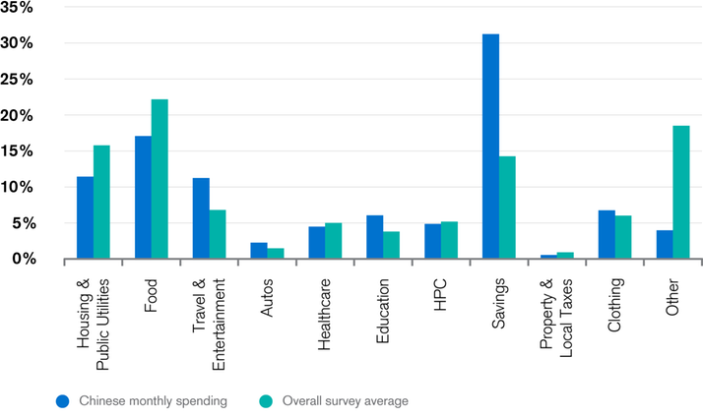
Chinese consumers are shifting their pattern of spending to discretionary items.
They are spending less on housing and food, but more on upgrading their lifestyles, on items such as healthcare, travel and entertainment compared to other emerging markets, according to Credit Suisse Research Institute's 7th Emerging Consumer Survey.
Monthly Spending in China
Source: Emerging Consumer Survey 2017

Slide 21
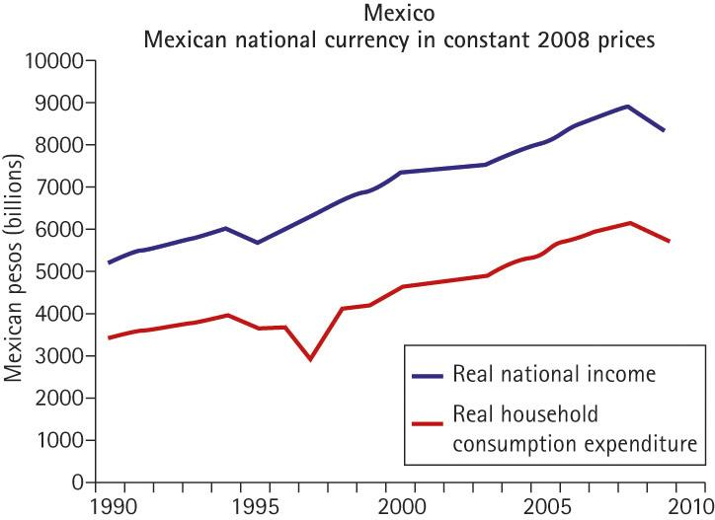
Expenditure patterns and trends
There is a close relationship between real income and consumer spending
As real incomes have risen in many countries, so too has total consumer spending
Other drivers of change in consumer spending patterns include these factors:
people are living longer
they have more leisure time
they are increasingly health conscious
there is increasing concern for the environment
more females have joined the labour force (social attitudes)
new technologies = new wants

Slide 23
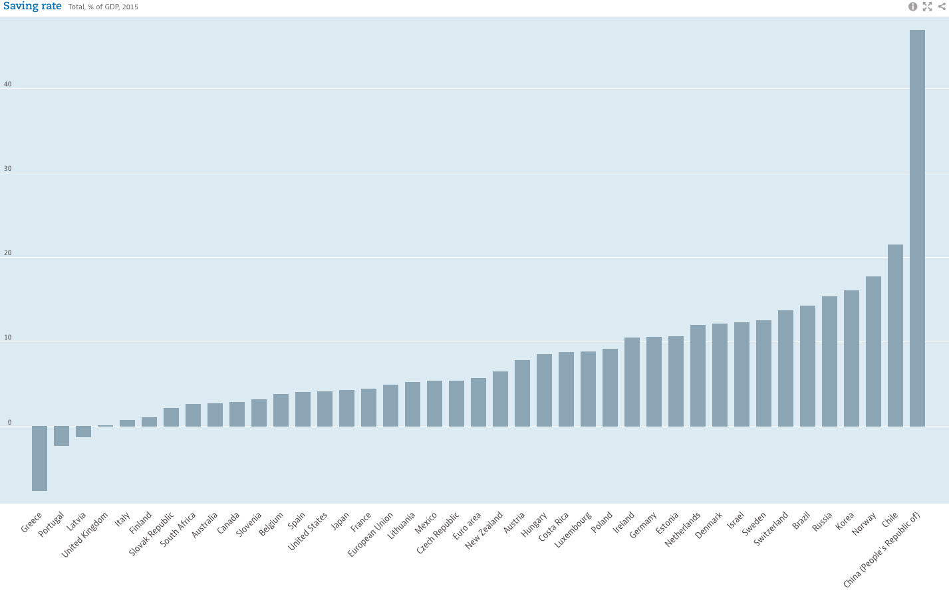

Slide 24
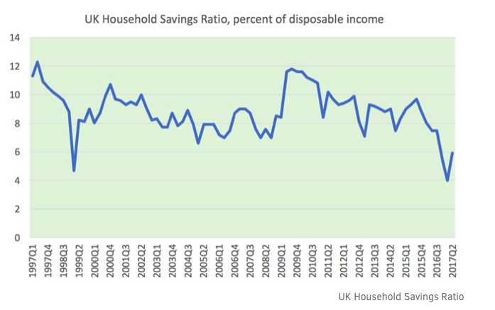

Slide 25
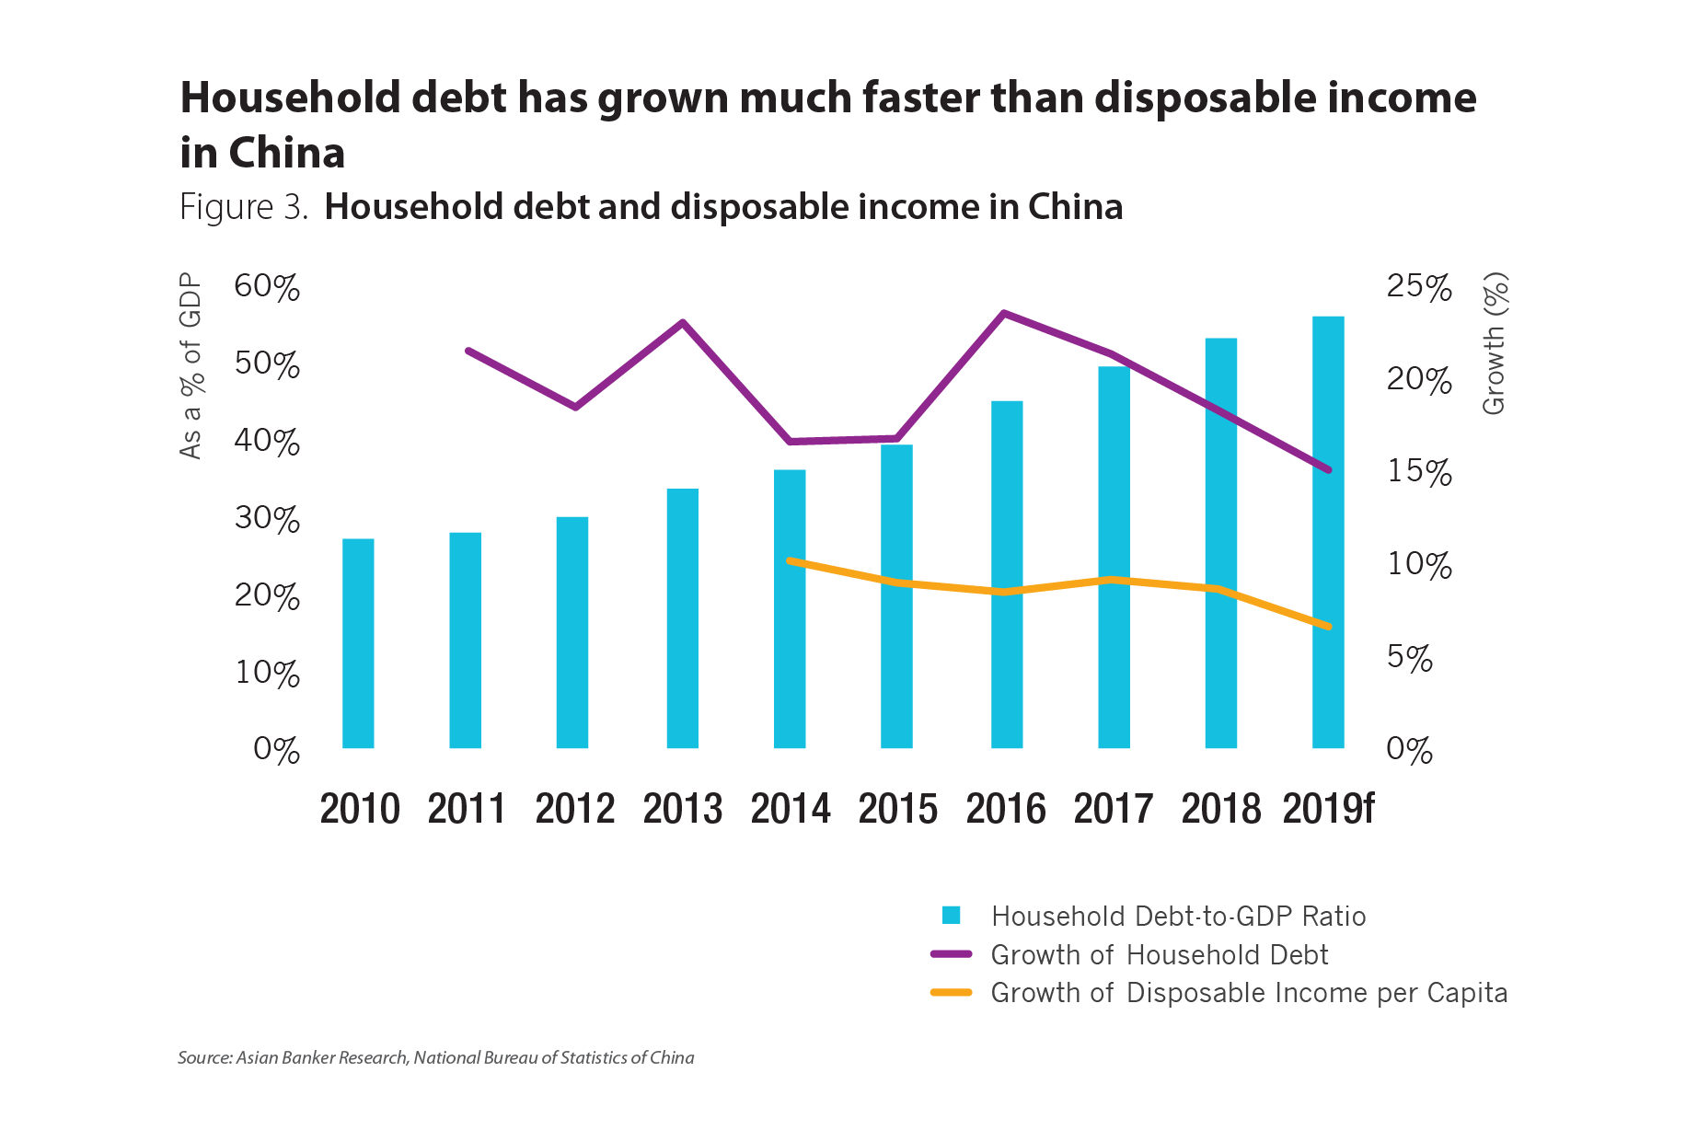
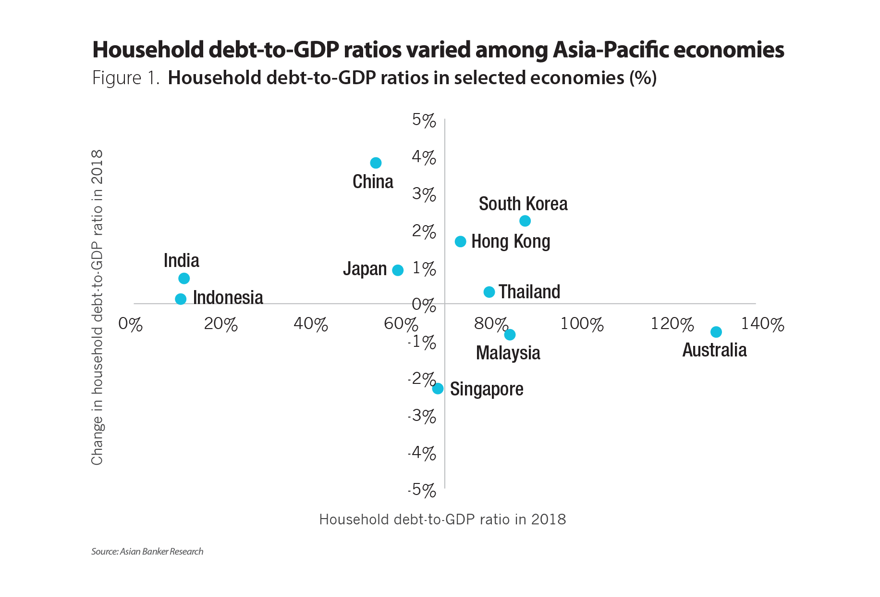

Slide 26
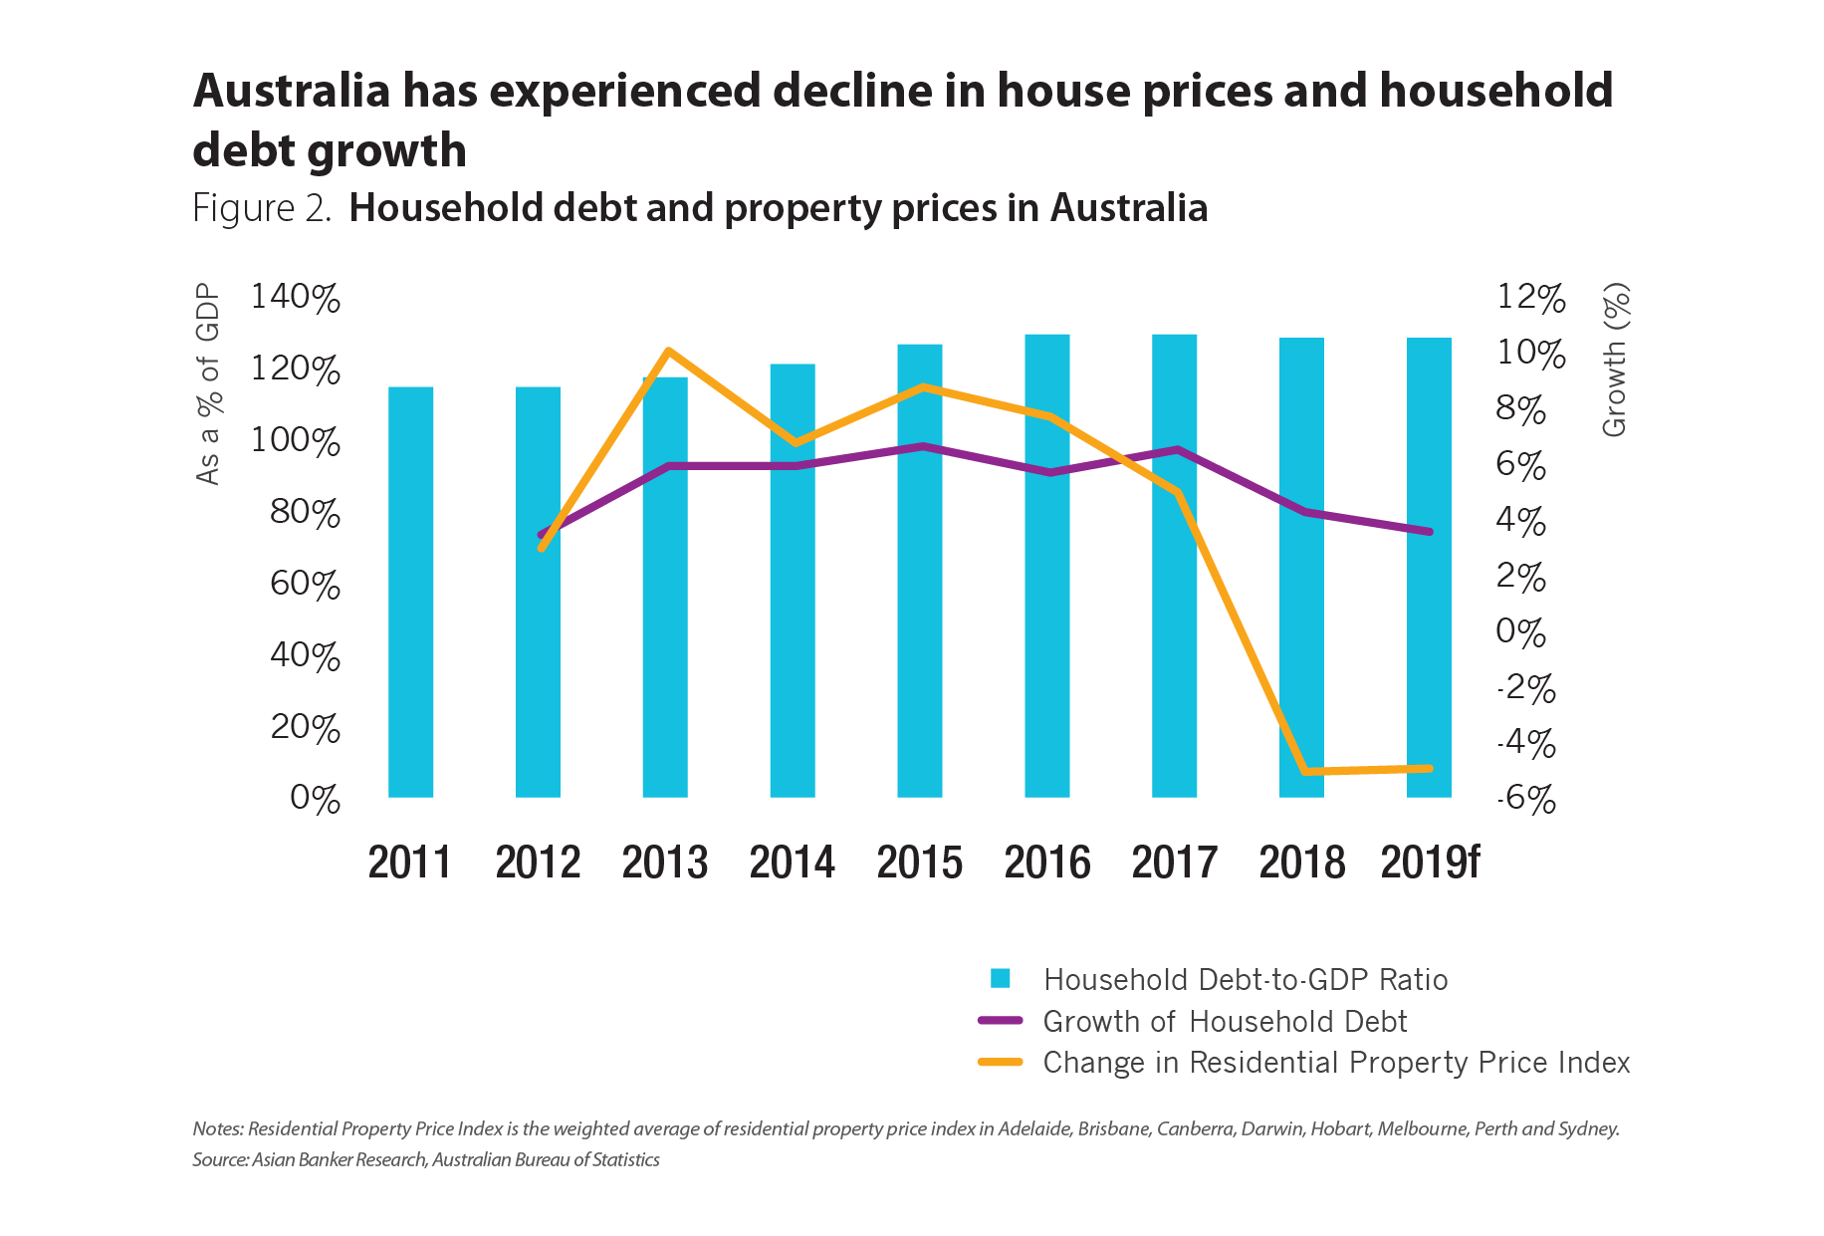

Slide 27
